Slide 1

Mathematical modelling for vaccine-preventable diseases
Epidemiology lecture 1
SIR models for simple epidemics
Katy Gaythorpe
School of Public Health
Imperial College London
k.gaythorpe@imperial.ac.uk
Notes:
Introduce who we are

Slide 2
Objectives of this lecture
By the end of this lecture you will have examined
what a compartmental model is
how transmission is modelled
a “rate” and how it relates to length of time
the average age of infection
the basic reproductive number, R0
and be familiar with common model structures

Slide 3


What is an epidemic?
CDC definition: the occurrence of more cases of disease, injury, or other health condition than expected in a given area or among a specific group of persons during a particular period. Usually, the cases are presumed to have a common cause or to be related to one another in some way.
Noticeable increase
Above expectation
Localized area
Given period of time
Outbreak: Similar to an epidemic… more localized
Pandemic: An epidemic across an extended geographical region

Slide 4
Common feature - transmission
Infectious diseases
Transmission between hosts
A case may also be a risk factor
An individual may be a source without being recognised as a case
People can be immune
Control measures have direct and indirect benefits
Control may be time sensitive

Slide 5
Modelling epidemics
Why do we model epidemics?
Predict the current conditions
Predict future progress of any given epidemic
Understand the mechanisms behind the epidemic
Understand which interventions might be successful

Slide 6
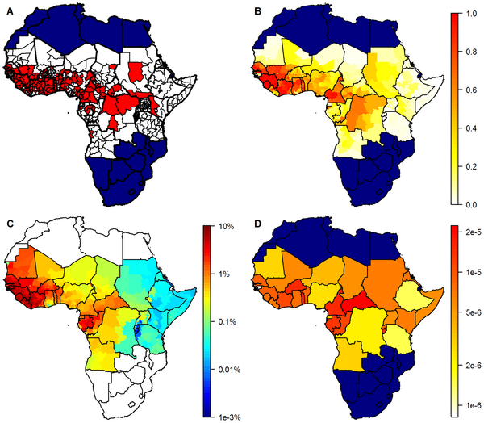

Burden of disease
How many people are infected with disease x?
Geographical distribution of yellow fever occurrence and transmission.
Presence/absence of yellow fever.
Model predictions giving the estimated probability of at least one yellow fever report.
Estimates of the annual force of infection.
Estimates of the country-specific detection probability per infection.
Garske T, Van Kerkhove MD, Yactayo S, Ronveaux O, Lewis RF, et al. (2014) Yellow Fever in Africa: Estimating the Burden of Disease and Impact of Mass Vaccination from Outbreak and Serological Data. PLOS Medicine

Slide 7
Future predictions
How many people will be infected with disease x?
https://acmedsci.ac.uk/file-download/51353957

Slide 8
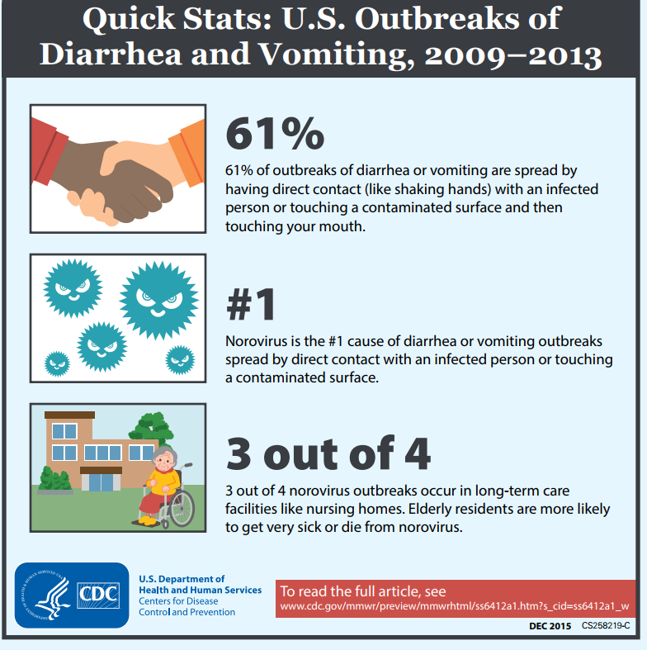
Understand mechanisms
How important is…?

Slide 9
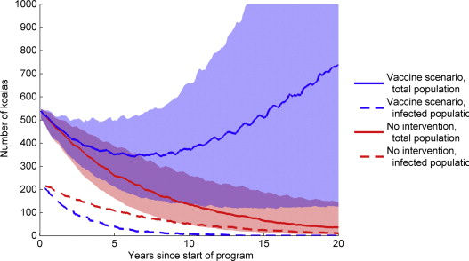
Test out control measures
What would happen if we introduced…?
Projected koala population size over the next 20 years in the absence of a vaccine programme, contrasted with a vaccine with a 75% average efficacy over 5 years, that prevents both infection and development of disease, administered to around 10% of koalas every year (as a percentage of the initial population), under optimistic assumptions about boosting, and without administering antibiotics to every koala vaccinated.
Andrew P. Craig, Jon Hanger, Jo Loader, William A.H. Ellis, John Callaghan, Cathryn Dexter, Darryl Jones, Kenneth W. Beagley, Peter Timms, David P. Wilson, A 5-year Chlamydia vaccination programme could reverse disease-related koala population decline: Predictions from a mathematical model using field data, Vaccine

Slide 10
Modelling epidemics
How do we model epidemics?
Identify key biological processes
Abstract them into a mathematical model
Investigate effect(s) of changing parameters

Slide 11
Compartmental Modelling
Timeline of infection and disease
time of infection
infectious period
infectious period
latent period
infectious period
latent period
latent period
infectivity
NOT infected
=
Susceptible
Infected and Infectious
Susceptible
(S)
Infected
(I)
transition between infection states at a given rate
Notes:
SI model

Slide 12


SI model
Mass-action mixing
Assume
fixed population of constant size (S+I=N)
All members of the population are in contact

Slide 13
Rate of infection
Susceptible
(S)
Infected
(I)
?
Rate at which a susceptible person gets infected depends upon:
The number or proportion of infected persons
The transmission rate
No infecteds, rate = 0
Notes:
“disjoint compartments” seems a bit overly complicated. What about just “individuals in a population can be categorised by their infection status”

Slide 14
Rate of infection
We are going to focus on frequency dependent transmission
This is the most appropriate for models in humans
Livestock models may use density dependent transmission
Notes:
“disjoint compartments” seems a bit overly complicated. What about just “individuals in a population can be categorised by their infection status”

Slide 15
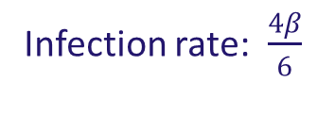
Rate of infection
Frequency dependent (frequency of infected people)
Infection rate: $\frac{4β}{6}$
Notes:
“disjoint compartments” seems a bit overly complicated. What about just “individuals in a population can be categorised by their infection status”

Slide 16
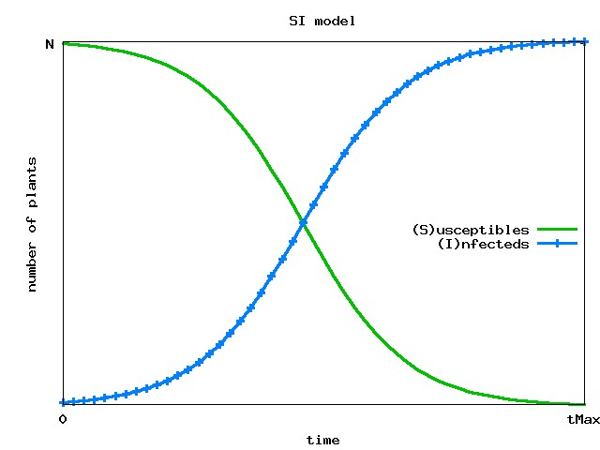
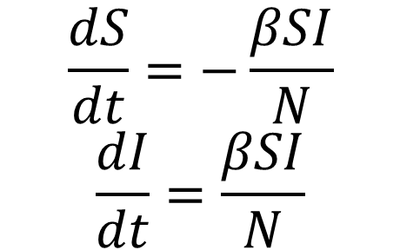
SI equations
Susceptible
(S)
Infected
(I)
$$\frac{dS}{dt}=−\frac{βSI}{N}$$
$$\frac{dI}{dt}=\frac{βSI}{N}$$

Slide 17
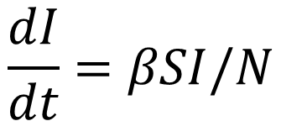
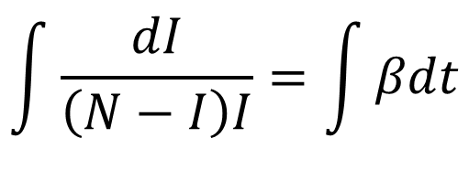
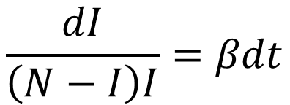
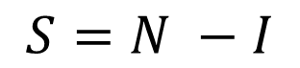
Solving the SI equations
$$\frac{dI}{dt}=βSI/N$$
Set
$$S=N −I$$
Separation of variables:
collect the I terms on the left and the t terms on the right
$$\frac{dI}{\left(N−I\right)I}=βdt$$
Integrate both sides with respect to time t (the LHS is more tricky)
$$\int{\frac{dI}{\left(N−I\right)I}}=\int{βdt}$$

Slide 18
Solving the SI equations
4. The Right Hand Side is easy!

Slide 19
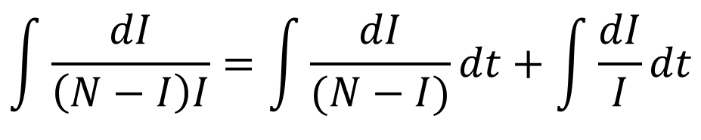
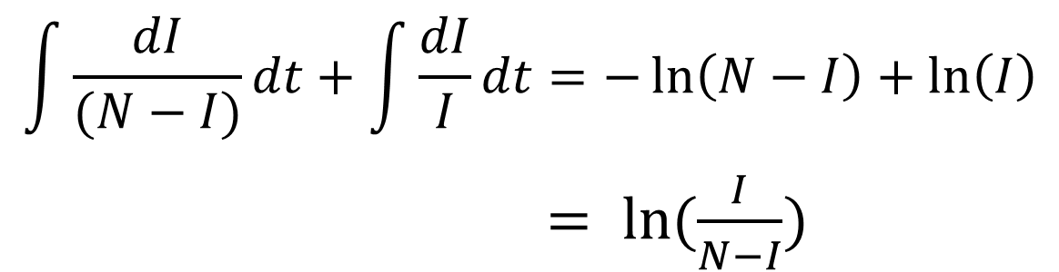
Solving the SI equations
The Left Hand Side is more fiddly
Partial fractions:
$$\int{\frac{dI}{\left(N−I\right)I}}=\int{\frac{dI}{(N−I)}dt+\int{\frac{dI}{I}dt}}$$
Integrate:
$$\int{\frac{dI}{(N−I)}dt+\int{\frac{dI}{I}dt}}=−\ln\left(N−I\right)+\ln\left(I\right)$$
$= ln⁡(\frac{I}{N−I})$

Slide 20
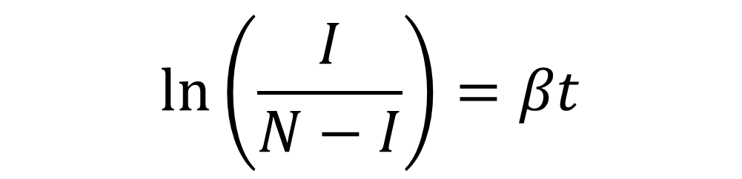
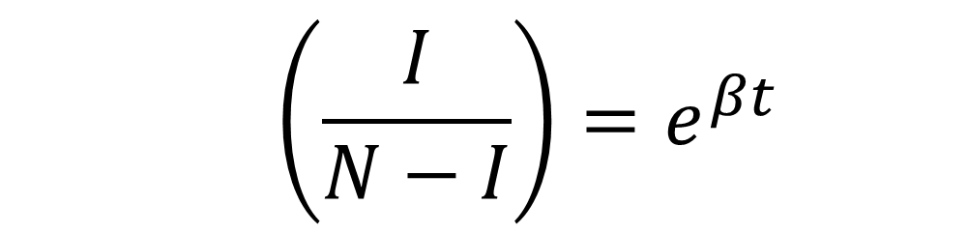
Solving the SI equations
Now we have the equation
Remember ln is the natural log
$$\ln\left(\frac{I}{N−I}\right)=βt$$
Take the exponential of both sides
$$\left(\frac{I}{N−I}\right)=e^{βt}$$

Slide 21
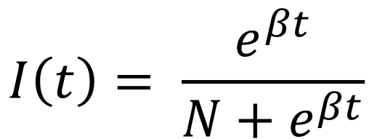
Solving the SI equations
Rearrange to make I(t) the subject of the formula
$$I\left(t\right)= \frac{e^{βt}}{N+e^{βt}}$$
In the limit, all individuals infected eventually
(rise but no fall)

Slide 22
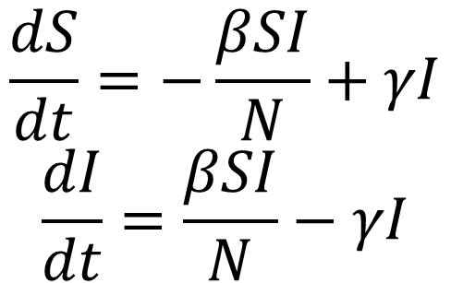
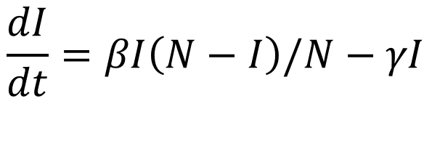
A common variant: SIS Model
Motivation
Diseases which
neither kill nor
confer long-lasting
immunity
Susceptible
(S)
Infected
(I)
Recovery rate
$$\frac{dS}{dt}=−\frac{βSI}{N}+γI$$
$$\frac{dI}{dt}=\frac{βSI}{N}−γI$$
$$\frac{dI}{dt}=βI\left(N−I\right)/N−γI$$
Notes:
Move to second lecture

Slide 23
A common variant: SIS Model
SI model
SIS model
Endemic equilibrium

Slide 24
How long are people infected for?
Constant risk of recovery at each time step
Solve…
18 out of 100 people have recovered after 1 day

Slide 25
How long are people infected for?
Average length of time infected =
Length of time infected =

Slide 26
Average age of infection
Force of infection
Question:
What’s the average age at which people get infected (for the first time)? or How long are people susceptible for?

Slide 27
Average age of infection

Slide 28
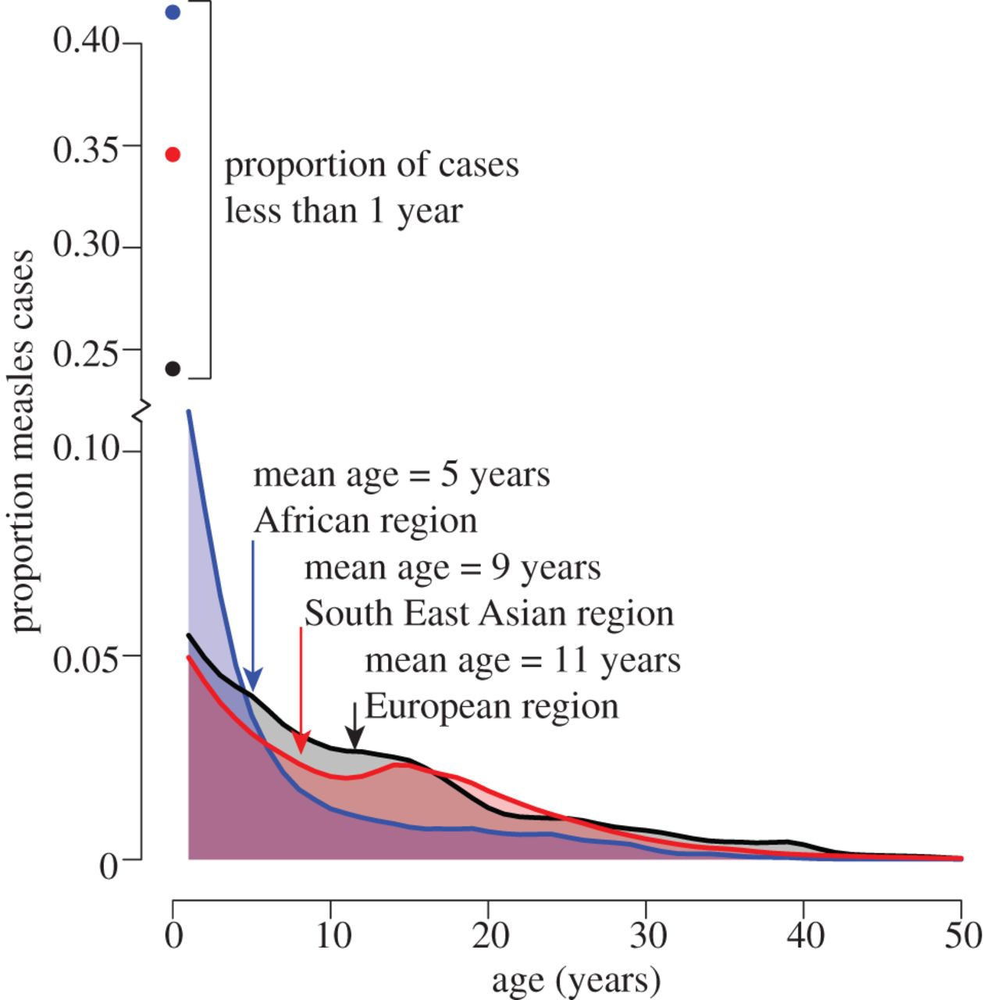
Endemic disease
Age distribution of measles cases reported by world region (blue = African region, red = South East Asian region, black = European region) from WHO case-based surveillance system, 2002–2010.
M. J. Ferrari et al. Phil. Trans. R. Soc. B 2013;368:20120141

Slide 29
SIR model
Timeline of infection and disease
time of infection
latent period
infectious period
immune
Susceptible
Infected
Recovered
Susceptible
(S)
Infected
(I)
Recovered
(R)
Average “infectious period” is 1/γ units of time

Slide 30
SIR model
R(t) represents the cumulative sum of all individuals that were infected

Slide 31
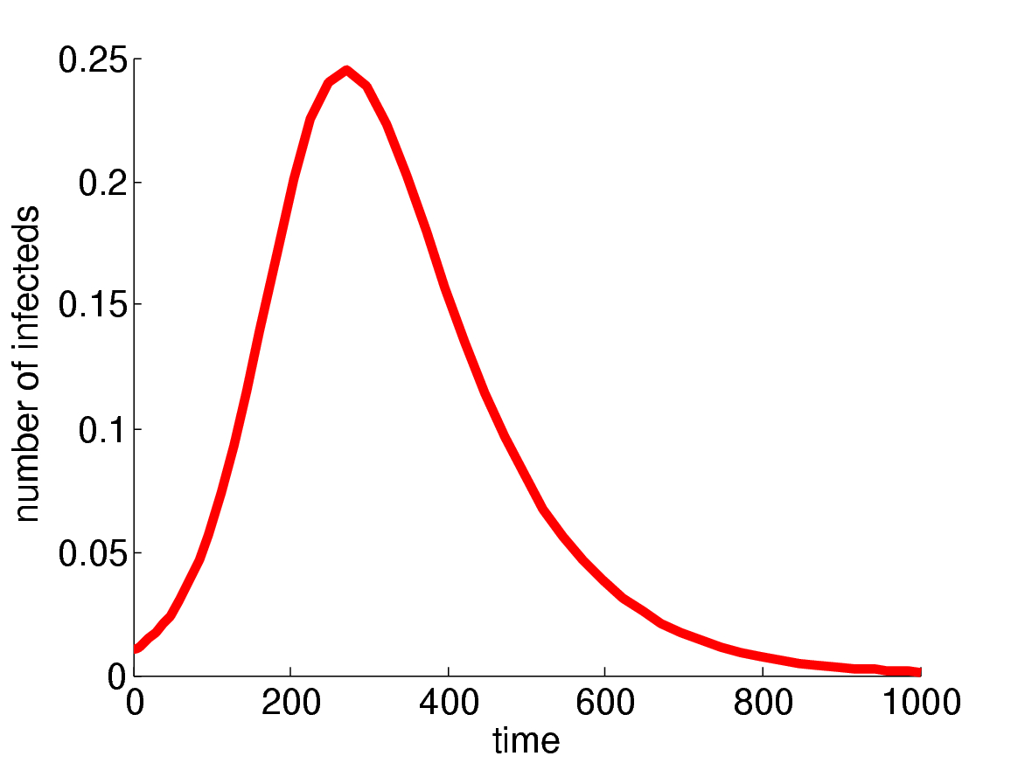
SIR model
Two key points emerge:
1) Disease burns itself out
2) Not all individuals infected
fraction infected
Such a simple model can represent pattern of real epidemics remarkably well

Slide 32
Basic Reproduction Number
Definition
R₀ is the expected number of secondary infections produced by one infected individual in wholly susceptible population
Disease can invade
Disease will eventually die out
R₀=1 is a threshold between no epidemic and an epidemic

Slide 33
An average infected person
Number of contacts
Average infectious period
An average infected person will generate
new infections

Slide 34
An average infected person
(At the start of the epidemic)
Effective contact rate
Average infectious period
An average infected person will generate
new infections
Basic Reproduction Number
R₀

Slide 35
Basic Reproduction Number

Slide 36
R₀ in SIR equations
R₀ not to be confused with compartment R!
Notes:
Check where the N is

Slide 37
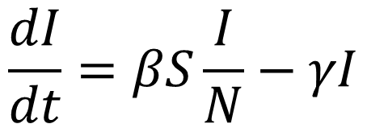
Estimating R₀
$$\frac{dI}{dt}=βS\frac{I}{N}−γI$$
At the start of an epidemic, S=N
Hence, we can estimate R₀ from initial exponential growth rate.
Notes:
KEN

Slide 38
R₀
What are the units of R₀ ?
No units
What factors not included in the model might affect estimates of R₀ ?
Under-reporting
Variable case definition
Population structure
Notes:
KEN

Slide 39
Summary
A compartmental model is defined by mutually exclusive infection states
Mass action mixing assumes everyone is in contact
Constant rate means exponentially-distributed waiting times
The basic reproduction number is the transmission rate multiplied by the average infectious period

